Slide 1


The Censorship of video games in china

Slide 2
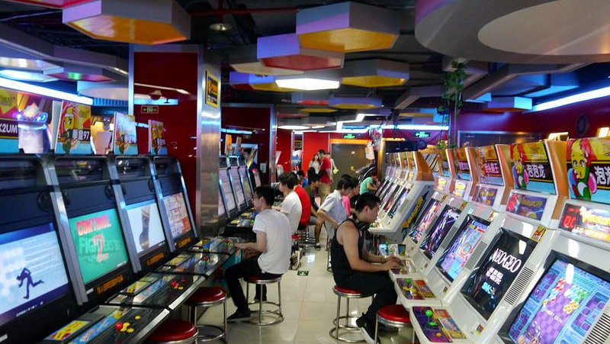
Introduction:
In recent years China has become a major consumer in the video game industry, however due to China's strict rules and regulations video game publishers have to be extra careful when deciding what is appropriate for China's political climate and cultural background. As such this has created an interesting dynamic between China and foreign video game publishers, which has led us to discuss the following topics within this presentation: Processes to get video games approved in china and restrictions, History and addiction of video games in China, The Chinese influence on the video game market.

Slide 3

Processes to get video games approved in China and restrictions.

Slide 4



There are core issues that video game publishers must take into consideration when beginning to localise their video game, such core issues include cultural adaptation, age rating and legality of content. However, rules, regulations and preferences change from country to country.
As a result of the rise of globalisation, China has become one of the most important and influential video game markets in the world. To enter the Chinese market, localisation teams often have to make cultural adjustments to video games in order to meet the high expectations and strict rules and regulations of China.

Slide 5

Video games are usually subject to stricter censorship than other forms of media, this is possibly due in part to the inherent interactive nature of video games and the fact that children often have access to video games not suitable for their age category. In China, there is no rating system for video games, which consequently means that all video games are potentially accessible to users of all ages. This leads to the heavy censorship of content in video games.

Slide 6

The Interim Provisions on the Administration of Internet Culture, issued in 2011 by the Ministry of Culture (Zhang 2012) include a number of contents to be forbidden:
1) those opposing the basic principles established in the constitution
2) those endangering the unification, sovereignty and territorial integrity of the state
3) those divulging secrets of the state, harming national security or
impairing the honour and interests of the state
4) those inciting the enmity, discrimination of nationalities,
jeopardizing the unity among the various ethnic groups, or violating
the customs and habits of minority nationalities
5) those spreading cults or superstitions
6) those disturbing social order and destroying social stability
7) those inciting pornography, gambling, violence or instigating a crime
8) those insulting or libeling others, violating the lawful rights and interests of others
9) those endangering social moralities or fine national cultural traditions
10) other contents prohibited by laws and administrative regulations or by the state

Slide 7

Many video games have been banned in China due to the interim provisions on the administration of internet culture, especially when it comes to the censorship of pornography, violence, gambling, political issues, and misinterpretation of historical facts.
While some of the elements stated in the document are quite clear, others like “fine national cultural traditions" are more subjective which makes trying to publish a video game in china much harder than in other countries.

Slide 8

Because of these loosely defined rules and regulations, China can ban games for seemingly no reason at all and without fair warning. However, china is a major opportunity for video game developers and passing up the opportunity of publishing in China would mean missing out big financially.
According to O’Hagan and Mangiron (2013: 224), developers and publishers usually have two options when faced with the problem of censorship: “a) to withdraw a game and not release it in that particular country, or b) to edit the objectionable content or remove it from the game”.

Slide 9

History & Addiction of Video Games in China

Slide 10

Japans influence in the Chinese game market
There was economic turmoil in China in the 1980s due to the lose of their leader Mao Zedong.
The country was very technologically far behind the western world.
Japan began to attempt to bring in games in the mid 80s due to a large video games market crash in America.
Japan were met with many barriers when trying to sell to the Chinese market.
The Chinese government had imposed massive 130% import tariffs making the games extremely expensive, second was a large amount of piracy, and black-market sales are games and consoles due to the lack of them before, these markets ignored copyright laws and made it impossible for a healthy game market to grow. (Liao, 2016).
Notes:
China initially began their entry into the video game market in the 1980s but was technologically very far behind the rest of the world at the time due to economic reform after the death of their leader Mao Zedong in the 1970s. Video games, consoles and arcade machines soon took off in China due to the massive video games market crash that took place in America which lead to Japan making their way into the Chinese market to attempt sell consoles and video games, only to be met by multiple barriers. The Chinese government had imposed massive import tariffs which made games extremely expensive to those trying to buy them. These tariffs lead to a fluctuation of black market selling and imports across the country. In turn the large amounts of video-games arcade games both legal and illegal lead to government intervention which added to the barriers in selling in China.

Slide 11
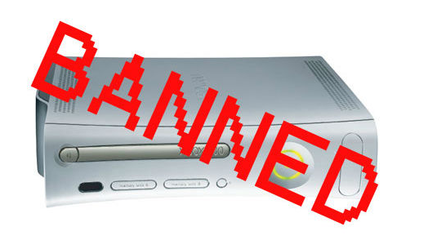
Introduction of Console Ban
After the influx of Video-Games, Arcade games and more to the Chinese market the Government began to deem it an addiction.
During the 90s the Government and even many of their people began to describe video-games as “Digital Heroin”.(Liao 2016).
Along with this in 2000 China introduced a console ban that wouldn’t be officially lifted until 2015.
Notes:
As the influx of video games came in so did the so-called addiction to the video games due to their large popularity among the population. Digital Heroin was a term thrown around constantly in describing video games as the Government was massively opposed to them. This lead to the government introducing a production and importation ban and nearly every console. I say nearly every console as Sony attempted to release the PlayStation 2 in 2 cities but due to the large price over import taxes it massively flopped. On top of this the ban did not include games on PCs and lead to a large increase in internet cafes that allowed gaming PCs to play these games that they couldn’t play on consoles and in later years mobile gaming began taking over in the video game industry. This console ban would be fully lifted again in 2015 allowing the manufacturing of consoles in China once again.

Slide 12

Addiction laws introduced
System brought into effect in 2005 by Ministry of Culture that affected players awards and experience points in-game after a certain amount of hours of game time.
This anti-addiction system, after three hours cuts into the rewards players can earn in-game, like experience points or equipment acquired by their character. After 5 hours, the system will issue warnings to the player that they have been playing too long along with giving damage to the character and cutting experience points that can be earned to a measly zero. (Dickie, 2005).
In 2007 this saw minors daily usage cut to 3 hours or less daily.
Notes:
In 2005 China eventually stepped in to combat this addiction in their country. The Ministry of Culture brought in a system that would affect players directly in game for playing too long. What this brought in was time warnings that popped up on the players in game display after 3 hours telling them the time they’ve played and cutting into the experience points they were able to earn. After 5 hours the system would give larger warnings along with damage to the players character if the game allows and would cut down the available experience points to 0. In 2007 this law also introduced a cap on the daily play time of minors to only 3 hours.

Slide 13

Pressure on Western Developers
Due to these laws tracking gamers play time there was pressure on developers outside of China to implement these changes in their game to enter the Chinese market.
The sheer size of the Chinese market is too much for some companies to lose out on.
Large companies like Blizzard, Riot Games and Epic Games have reportedly hired Chinese counterparts to implement these changes especially due to the tightening of the law in 2019.
Notes:
The introduction of these laws puts high amounts of pressure on the Developers outside China as now to publish their game in China they must comply with the laws in ordered for the game to be approved. Which while it is a challenge of morality due to privacy issues some companies need the Chinese market to maximise their income and keep moving forward due to the sheer size of the Chinese market and the amount of people that play games. Three notable companies that reportedly hired Chinese counterparts to implement these changes in their games for the Chinese release are Blizzard, Riot Games and Epic Games. All three of these companies have games with overwhelming support from their Chinese audience. These companies would definitely like to comply with these laws especially with the tightening of the laws which occurred in 2019.

Slide 14

Tightening of laws in 2019
These changes will warn younger players of their playtime after three hours on weekends and doesn’t allow players to play between the hours of 9p.m. And 8a.m. on weekdays. (Cutchin, 2019).
Minors gameplay is capped at 90 minutes daily Monday to Friday and are not allowed to play between 9p.m. and 8a.m.
On weekends they are allowed three hours up until 10p.m.
Notes:
In 2019 laws were again tightened to combat addiction of video games especially in Younger children. These laws brought in only allowed people under the age of 18 to play 90 minutes of video games between Monday and Friday and 3 hours on the weekend. They were also not allowed to play after 9pm at night on weekdays and 10 pm on weekends. Children find ways around these laws by using parents phones or someone elses I.D. to log in to allow them to play for longer but they are unable to progress their own account after they have exceeded these limits.

Slide 15

Tightening of Laws 2019
The tightening of laws in 2019 also brought with it restrictions on micro transactions in all games.
The spending limit like the time restrictions also goes by age and ranges between $28 a month to $57 a month depending on your age.
All of these in game restrictions are tracked by the person being required to use their real name to sign up for the account.
However due to children finding ways around this a new system is being brought into place to prevent this by the use of the persons actual government I.D. number.
This all feeds massively into Chinas influence in the game industry.
Notes:
Alongside the restrictions to younger players was the restrictions on the amount of money you can spend on micro transactions or in-game currency. These limits varied from 28 dollars a month to about 57 dollars a month depending on the age of the individual playing the game minors being able to spend the least on the game. The government tracked these accounts by the name of the individual signing up for the account and matched that name to an I.D. number. This ultimately lead to the use of fake i.d.s to get into arcades and younger people using their parents or grandparents names for signing up to accounts to allow them play for longer periods. While some games and places required people to use their I.D. numbers and even facial recognition for some to play the games not all did, now In 2020 China have introduced a system that requires players to use their own I.D. number to sign up for games and arcades not allowing them to use others names. These laws on top of the strict laws for publishing games in country are an attempt to eradicate the addiction to video games that the government believe is very prominent in their country.

Slide 16

Chinese Influence
On the Worldwide Gaming Market

Slide 17
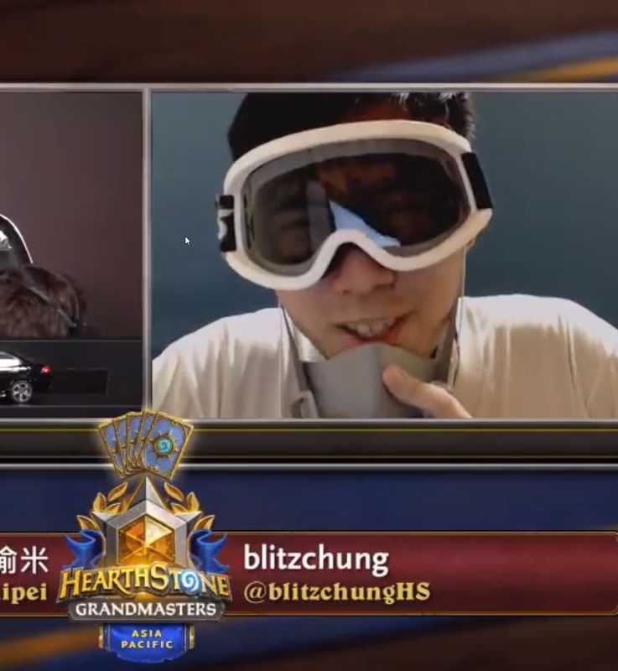
E-sports: Blitzchung Controversy
Blitzchung: Pro Hearthstone player
In a post game interview: “Liberate Hong Kong. Revolution of our age.”
Blizzards “rule” against his action: “Engaging in any act that, in Blizzard’s sole discretion, brings you into public disrepute, offends a portion or group of the public, or otherwise damages Blizzard image…”
Notes:
https://twitter.com/i/status/1180954142396710912

Slide 18

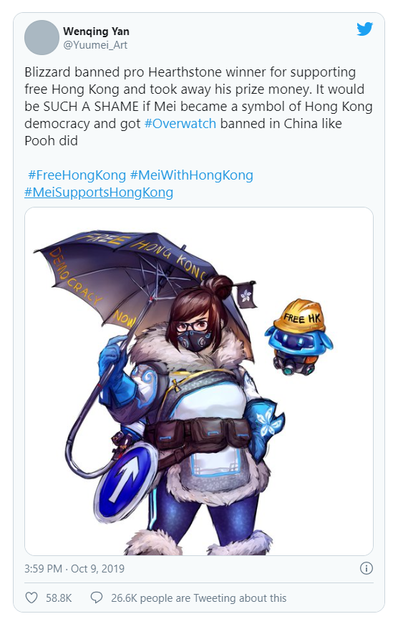
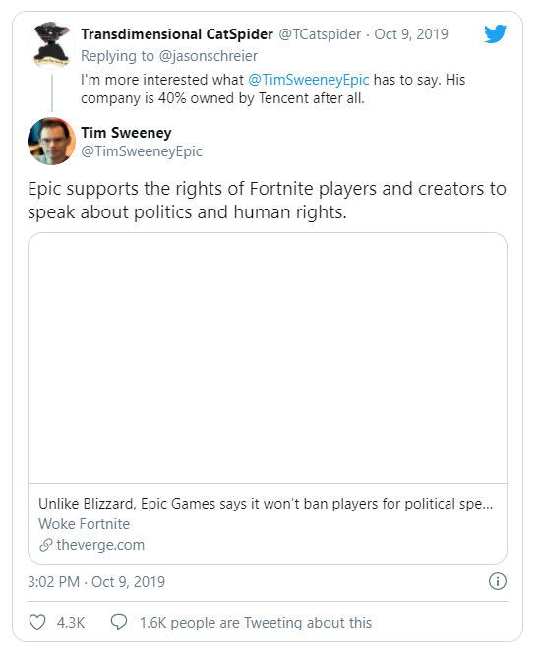
Response:
Notes:
Tim Sweeney is proof that Blizzard didn’t need to act as harshly

Slide 19

E-Sports: Shanghai or Beijing
“Chinese government to designate it as one of several 'national pillar industries’” in early 2000s.
Beijing revealed a plan to become the "international capital of online games" by no later than 2025.
“2015 Shanghai had already announced its plan to become "the international capital of Esports", with the local government unveiling plans to invest in fast broadband infrastructure, esports stadiums and even 'Esports industrial parks’”
Notes:
https://www.pocketgamer.biz/asia/comment-and-opinion/72500/china-has-a-big-plan-to-become-the-global-centre-of-the-games-industry/

Slide 20
Cyber Recreation District
Late 2000s, planned to be a Second Life type.
150m avatars, 7m online at one time.
“China is converting a 100 sq km site (yes, that is a very big space) on the former nationalised steel mill site to house, among other things, virtual worlds able to support not millions or tens of millions but billions of avatars.”

Slide 21

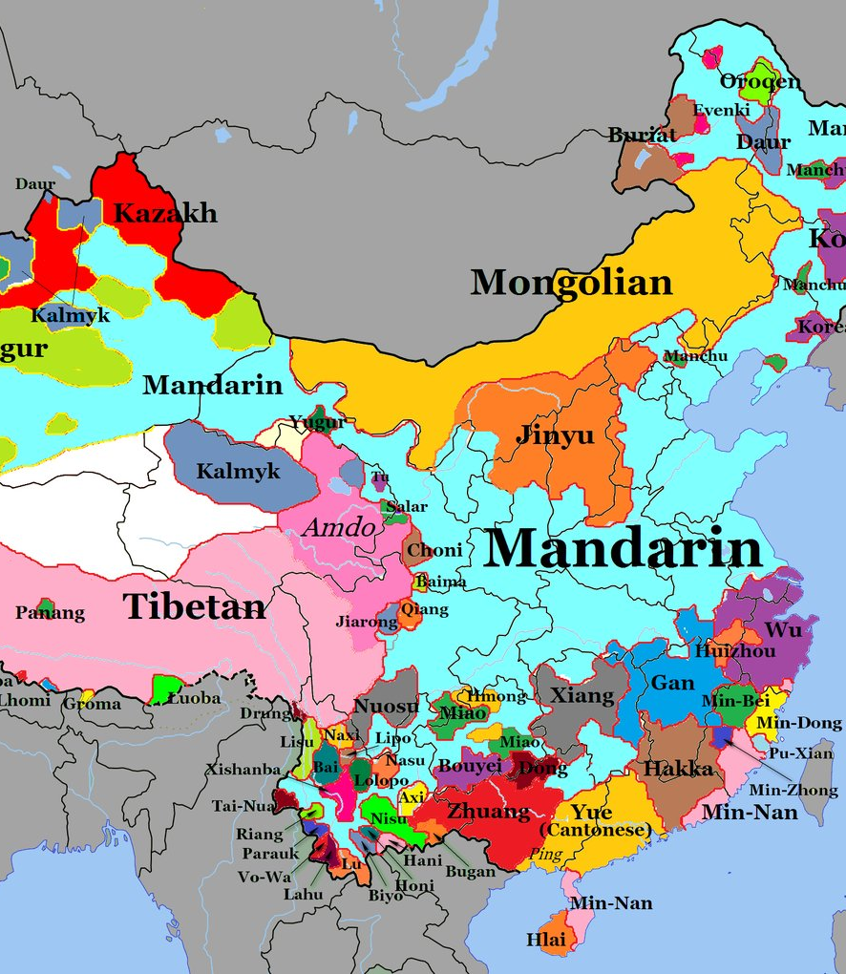
Pokémon: Mandarin vs Cantonese
Hong Kong speaks Cantonese, has different names for the game (Pet Little Elves)
Whereas mainland China speaks Mandarin (Spirit Pokémon)
Nintendo planned to make the new games in Mandarin only, for commercial simplicity

Slide 22

Conclusion
Much like in the biblical story the Tower of Babel, linguistic difficulties and cultural identities can mean the end of cooperation, and as such an end to peace. We must strive for understanding between nations, or our structures will crumble.

Slide 23
References
Liao, S X. T. (2016), ‘Japanese Console Games Popularization in China: Governance, Copycats, and Gamers’, Games and Culture 2016, Vol. 11(3) 275-297.
…….(Liao, 2016). ….
Dickie, M. (2005), “China moves to zap online game addiction". Available: https://www.ft.com/content/89ea206a-13f3-11da-af53-00000e2511c8 Financial Times. 2005-08-23.
…….(Dickie, 2005)……..
Cutchin, J.B. (2019) "How U.S. video game companies are building tools for China's surveillance state". Available: https://www.latimes.com/business/story/2019-07-21/american-game-developers-china-surveillance
The Los Angeles Times.
……(Cutchin, 2019)…….

Slide 24
References (Cont.)
"China Launches China Cyber Recreation District" https://sulis.ul.ie/access/content/group/8bbe186b-f2d4-418b-9939-6280df7bed47/Reading%20for%20presentations/Articles/Country%20specific/China%20Launches%20China%20Cyber%20Recreation%20District%20_%20MultiLingual.pdf
"What to Know About Blizzard, Hong Kong and the Controversy Over Politics in Esports" https://time.com/5702971/blizzard-esports-hearthstone-hong-kong-protests-backlash-blitzchung/
"Why the plan to rename Pikachu has made Hong Kong angry" https://www.bbc.com/news/world-asia-china-36414978
"Beijing and Shanghai want to be global gaming capitals, but content controls are a problem" https://www.scmp.com/abacus/games/article/3043049/beijing-and-shanghai-want-be-global-gaming-capitals-content-controls

Slide 25
References
Tabea De Wille and Piertommaso Bottura(2020) “The rules of harmony Video game censorship in China”
https://multilingual.com/issues/may-jun-2019/the-rules-of-harmony/
Luo Dong and Carme Mangiron(2018) “Journey to the East: Cultural adaptation of video games for the Chinese market” https://www.jostrans.org/issue29/art_dong.pdf
Kah Hui Teo and Joelle Tjahjadi (2020) “Culturalization, game localization and China”
https://multilingual.com/issues/aug-sep-2018/culturalization-game-localization-and-china/

